Slide 1


NUMBER SYSTEM CONVERSION.
CIT. 1st Year CIT - 134

Slide 2

HEXADECIMAL TO BINARY CONVERSION.
Hexa | 0 | 1 | 2 | 3 | 4 | 5 | 6 | 7
Binary | 0000 | 0001 | 0010 | 0011 | 0100 | 0101 | 0110 | 0111
Hexa | 0 | 1 | 2 | 3 | 4 | 5 | 6 | 7
Binary | 0000 | 0001 | 0010 | 0011 | 0100 | 0101 | 0110 | 0111
Hexa | 8 | 9 | A | B | C | D | E | F
Binary | 1000 | 1001 | 1010 | 1011 | 1100 | 1101 | 1110 | 1111
Hexa | 8 | 9 | A | B | C | D | E | F
Binary | 1000 | 1001 | 1010 | 1011 | 1100 | 1101 | 1110 | 1111
CIT. 1st Year CIT - 134

Slide 3
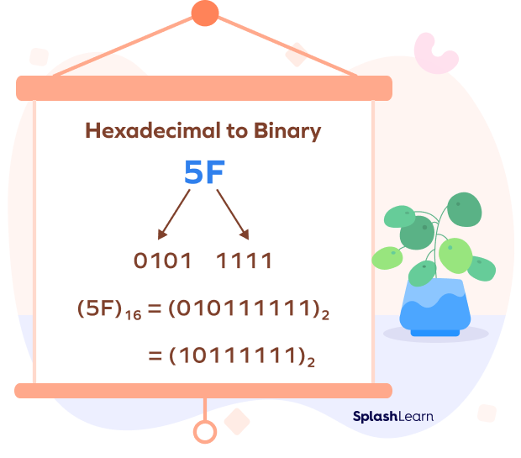
Example: Let’s convert the hexadecimal number “2A” to binary:
“2” in hexadecimal is equivalent to “0010” in binary.
“A” in hexadecimal is equivalent to “1010” in binary.
Therefore, “2A” in hexadecimal is equivalent to “00101010” in binary.
CIT. 1st Year CIT - 134

Slide 4
Binary to hexadecimal.
Example-1 −(1010101101001)₂ = (1 0101 0110 1001)₂ = (0001 0101 0110 1001)₂ = (1 5 6 9)₁₆ = (1569)₁₆
Example-2 − Convert binary number 001100101 into hexadecimal number.
Example-3 _ What will you get if you convert (11011110)₂ into a hexadecimal number system?
Solution:
Form the groups of four digits.
(11011110)₂ = 1101 | 1110
1101₂ = D₁₆
1110₂ = E₁₆
So, (11011110)₂ = (DE)₁₆
CIT. 1st Year CIT - 134

Slide 5

Practice Problems on Binary to Hexadecimal Conversion
1 - Find the value of (11110101)2 in the hexadecimal number system.
2 - What is the value of (01111011)2 into a hexadecimal number system?
3 - Convert (10101001)2 into a hexadecimal number system.
CIT. 1st Year CIT - 134

Slide 6
HEXADECIMAL TO DECIMAL
AND
DECIMAL TO HEXADECIMAL
CONVERSIONS.
CIT. 1st Year CIT - 134

Slide 7

Example 1 : Convert (1DA6)₁₆ to decimal.
Solution:
(1DA6)₁₆
Here,
1 = 1
D = 13
A = 10
6 = 6
Thus,
(1DA6)₁₆ = (1 × 16³) + (13 × 16²) + (10 × 16¹) + (6 × 16⁰)
= (1 × 4096) + (13 × 256) + (10 × 16) + (6 × 1)
= 4096 + 3328 + 160 + 6
= 7590
Therefore, (1DA6)₁₆ = (7590)₁₀
CIT. 1st Year CIT - 134

Slide 8
Example 2: Convert (E8B)₁₆ to decimal system.
Solution:
(E8B)₁₆
Here,
E = 14
8 = 8
B = 11
Thus,
(E8B)₁₆ = (14 × 16²) + (8 × 16¹) + (11 × 16⁰)
= (14 × 256) + (8 × 16) + (11 × 1)
= 3584 + 128 + 11
= 3723
Therefore, (E8B)₁₆ = (3723)₁₀
CIT. 1st Year CIT - 134

Slide 9
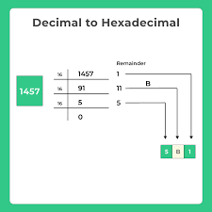
(1457)₁₀ CONVERT INTO HEXADECIMAL.
CIT. 1st Year CIT - 134

Slide 10
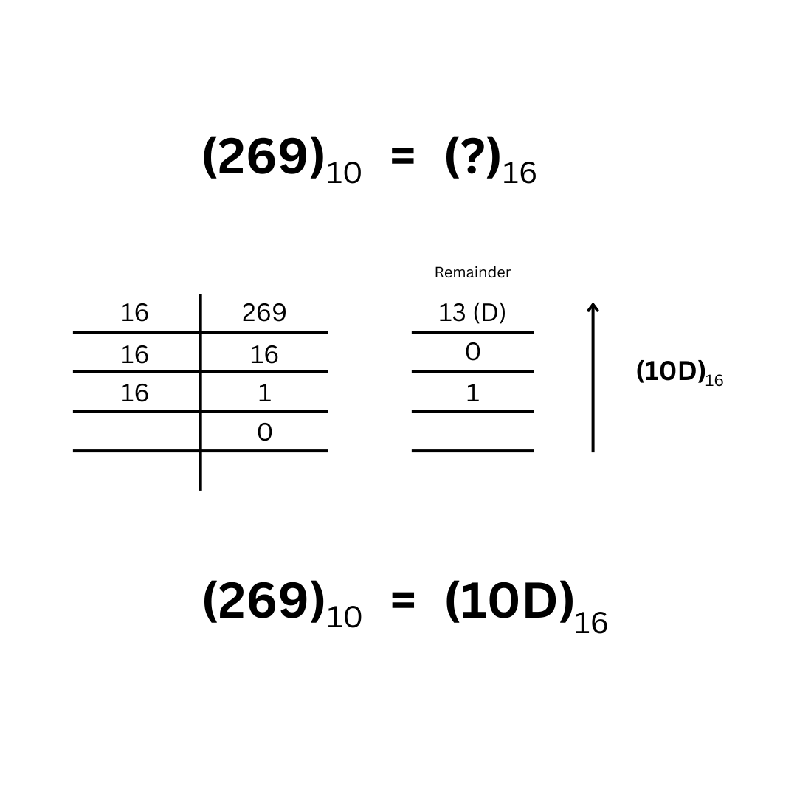
CIT. 1st Year CIT - 134

Slide 11
Convert the following decimal numbers to hex. (i) 205 (ii) 450 (iii) 199 (iv) 3000
CIT. 1st Year CIT - 134

